Slide 1
Data at Work
Open Data and the Future of Workforce
Matt Gee
Notes:
Skills at Work

Slide 2
Notes:
This is Jeniffer
Community college several semesters until she had to drop out to care for her ailing mother
Got a job at a call center and worked her way up to manager
The company that emplyed her call center switched to an AI-based automated customer support and Jennifer and her colleagues were laid off
A difficult choice: go back to community college to aquire new skills and credentials, or find
Her choice is made all the more challenging because of the lack of public data on how skills, training, and jobs connect in her area.

Slide 3
Notes:
Jennifer’s challenge is not unique.
Whether it’s a military spouse moving to a new area, a jobs training program deciding on which skills to teach for the local market, an HR analytics company trying to build better hiring recommendation engine, or a labor market researcher trying to quantify regional skill stability.
They all are held back by the fact that the pace of change in the labor market has outstripped the pace of change in our open data about skills, training, and jobs.
Because our open data about the labor market isn’t keeping up with the labor market itself.

Slide 4
The pace of change in the labor market has outstripped the pace of change of our public data on skills, training, and jobs
Notes:
An so, a group of us, from government, academia, and instustry, led
Create a dictionary and thesaurus for skills in the American workforce
Be a data scientist
Provide context, advance the field
With the API you have the opportunity to truly help the individual
Activating the data
When you get the bigger picture
Data science isn’t about using data

Slide 5
“We must become more specific and much faster in understanding the changes underway…
The Future of Jobs Report
World Economic Forum, 2016

Slide 6

Notes:
And so, a year ago last week, a group of us from government, academia, and industry, lead by the late Jake Brewer, came together to try and meet this challenge. Coming out of that meeting, we launched the White House’s Workforce Data Initiative, with it’s first major project, a public-private partnership aimed at improving the granularity of standard skill and jobs data.

Slide 7








Open Skills Project: A public-private partnership to improve open data on skills and jobs
Open Skills Cooperative
Pooling public and private data into a private data store
Open Skills Research and Development Group
Data scientists, machine learning and AI researchers
Open Skills API
Building applications on top of the Open Skills API
Open Skills Developer Partners
9 months of negotiating unique legal and governance structure
Economists
Taxonomists, and other subject matter experts
Open aggregate data resource of raw and normalized skills & jobs, and how they relate to each other in time and place
Supporting veterans’ spouses, career one-stop-shops, & industry use cases
Open Skills Database
Notes:
Use cases, intervening military spouses, legal team working out complex data sharing agreements and governance models

Slide 8
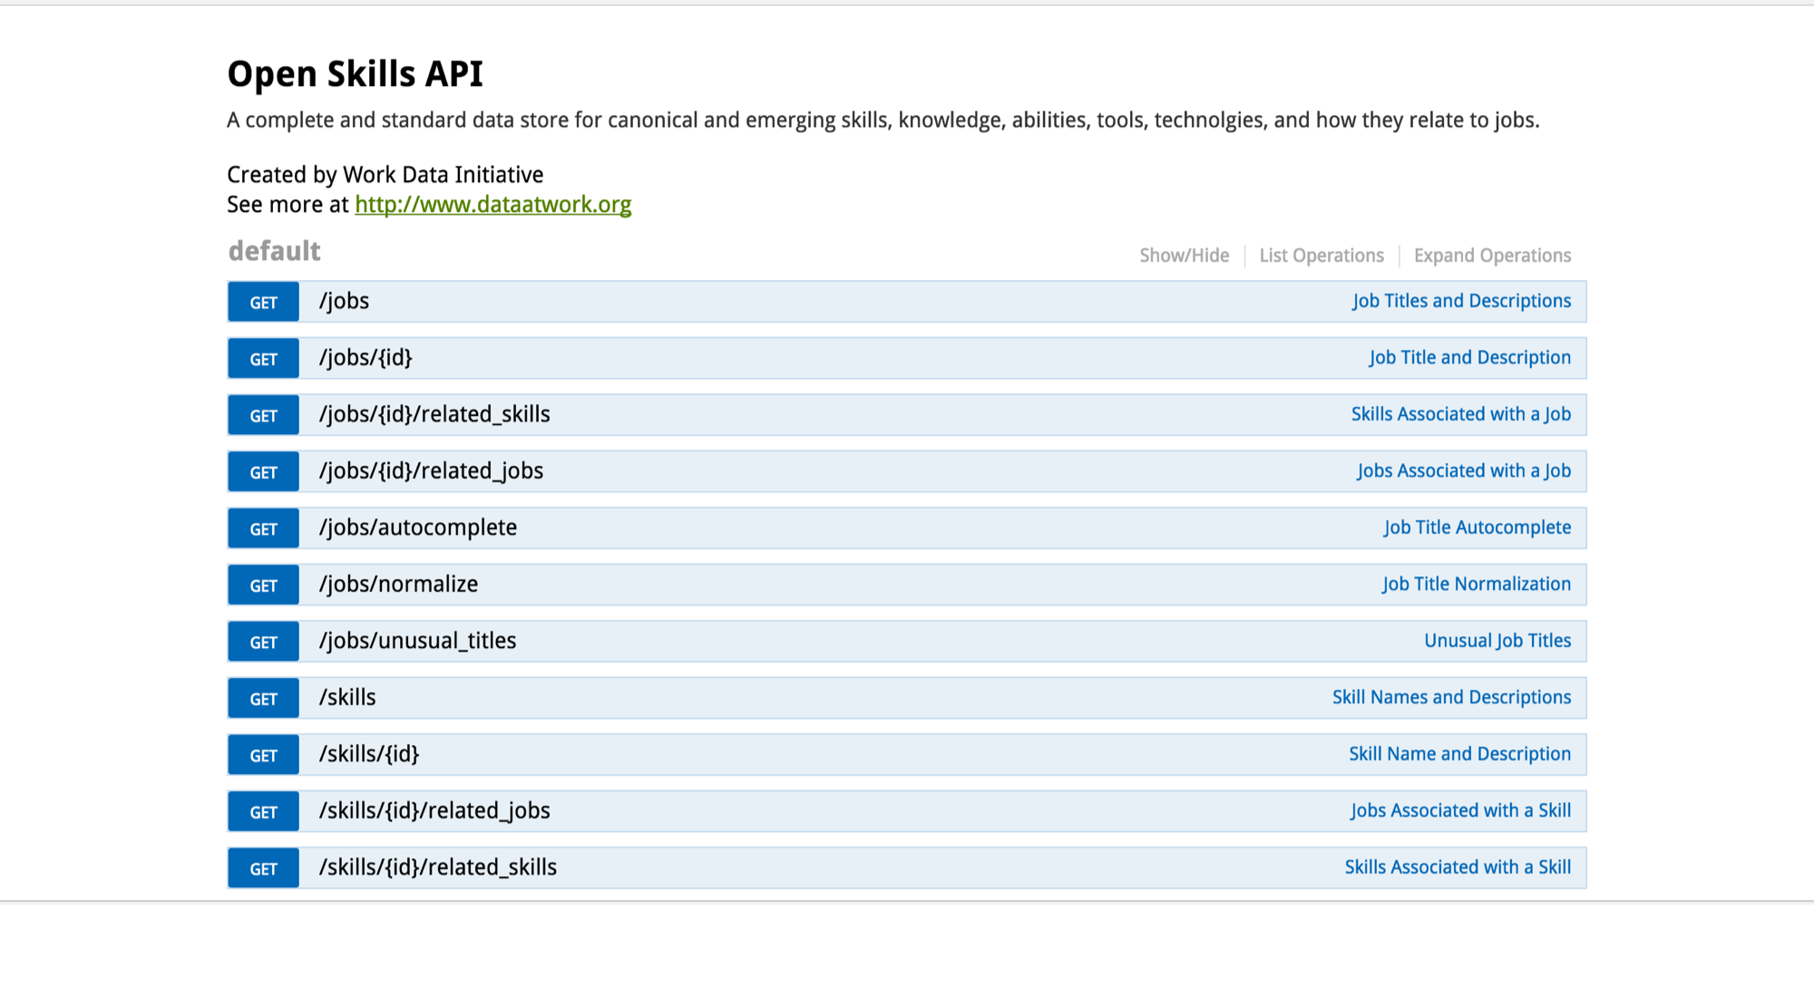

Slide 9
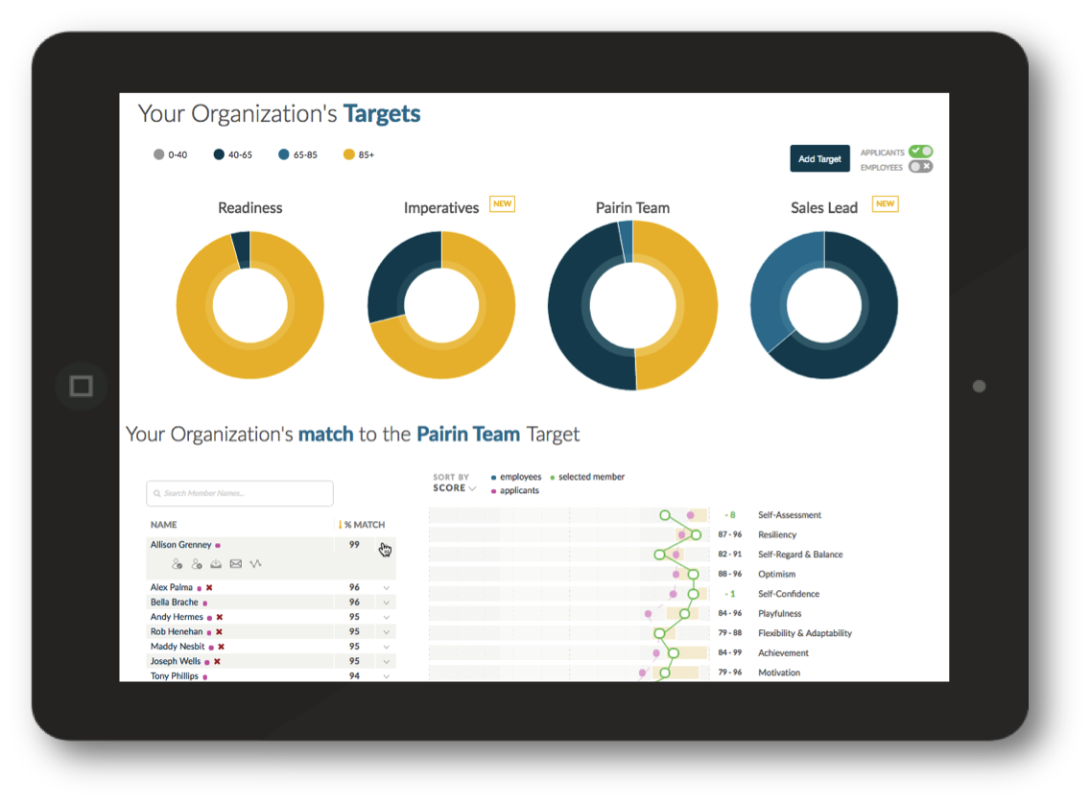
Notes:
Several companies, like Pairin, have built Open Skills API into their product as part of the Opportunity Project and will be demoing them next week.

Slide 10

How You Can Help
Data Partners
Research Partners
Developer Partners
Notes:
But this effort is just starting. We need your help
Join the Skills Cooperative, adding your data and your voice to the governance of the effort.
Join the research group and help solve some of the thorniest technical issues in deep learning or labor economics.
Join the developer group and build new apps on top of new use cases.
Use weather data comparison
Infographic that shows the scale of impact. Add infographic

Slide 11
Help us put open data to work for the American worker
dataatwork.org
info@dataatwork.org

